Slide 1




HEART DISEASE DATASET ANALYSIS
POWER BI
REINFORCEMENT PROJECT
PRINESH ROUT
DA & DS

Slide 2
PROJECT OVERVIEW
This project analyzed a heart disease dataset using Power BI to identify key factors associated with heart disease. Patient demographic and clinical data were cleaned, transformed, and modeled using Power Query and DAX. Interactive dashboards and visualizations were created to uncover trends, compare risk factors, and support data-driven insights in healthcare analysis.
Tools Used: Power BI, DAX, Power Query
Dataset Source: Kaggle – Heart Disease Dataset
GOALS
To analyze heart disease data and identify key demographic and clinical risk factors.
To clean, transform, and model healthcare data using Power Query and DAX.
To create interactive Power BI dashboards for effective visualization and analysis.
To support data-driven insights for understanding heart disease patterns.

Slide 3
DATA DESCRIPTION & PREPROCESSING
The heart disease dataset sourced from Kaggle contains patient demographic and clinical attributes such as age, gender, chest pain type, blood pressure, cholesterol levels, heart rate, and exercise-induced indicators. The dataset is used to analyze and predict the presence of heart disease based on these medical factors.
Dataset Source: Kaggle – Heart Disease Dataset
Data preprocessing was performed using Power Query to ensure data quality and reliability. This included removing duplicate records, handling missing values, correcting data types, validating categorical variables, and transforming coded attributes into meaningful labels. These steps prepared the dataset for accurate analysis and visualization in Power BI.

Slide 4
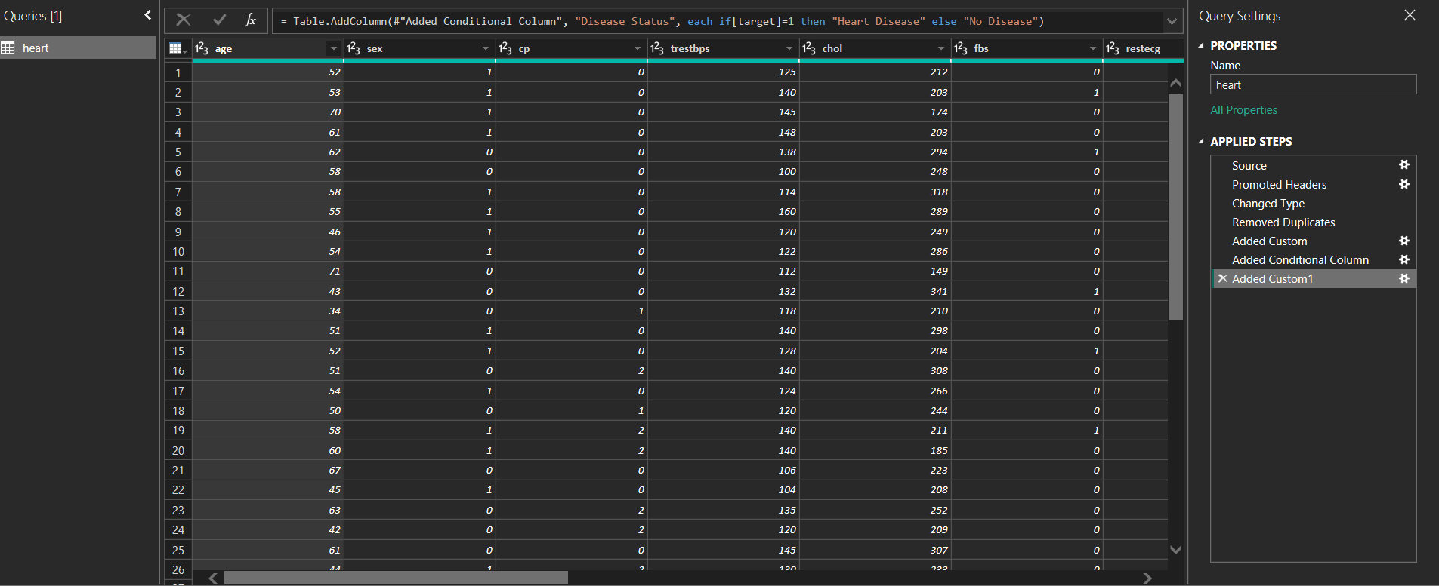
CLEANING & HANDLING MISSING VALUES
Missing values were identified and treated using appropriate replacement techniques based on data type and domain relevance. Invalid records were corrected or removed to ensure data accuracy and reliability for Power BI analysis.

Slide 5
KEY METRICS CALCULATIONS
Age by Group
Average Cholesterol
Avg age of Disease
Chest Pain Type
Disease Percentage
Disease Status
Heart Disease Patient
High Risk Patient
Max Heart Rate
No Heart Disease Patient
Selected Patient

Slide 6
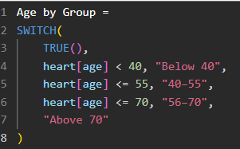




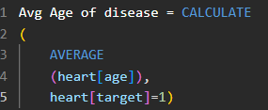
DAX CALCULATIONS

Slide 7
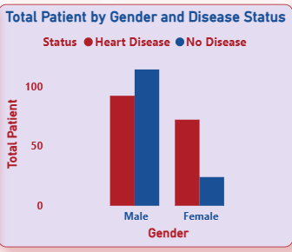
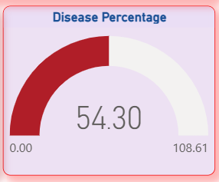
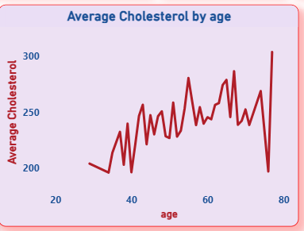
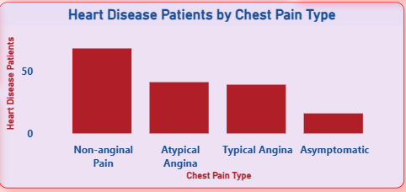
CHARTS & VISUALIZATION

Slide 8
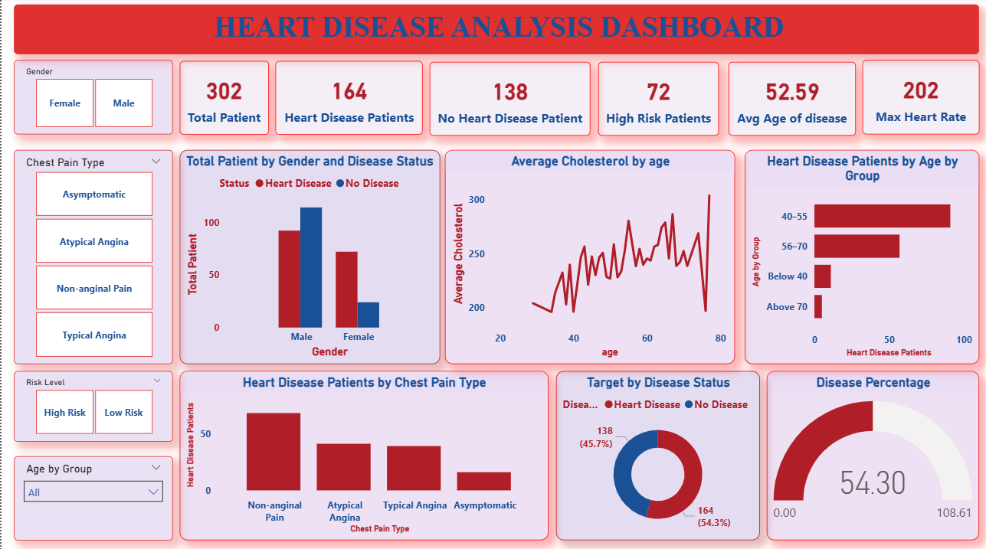
DASHBOARD OVERVIEW

Slide 9
RESEARCHED INSIGHTS
Total Patients :302 whereas number of heart disease patients:164(~54.3%)
No heart disease patient found(~45.7%) which indicates half of the patients are affected indicating a high prevalence of heart disease in the dataset.
Males show significantly higher heart disease cases compared to females whereas females show lower proportion of heart disease which indicates Gender is a strong risk factor ,with males being more vulnerable.
Nonanginal pain has the highest number of heart disease patients & Atypical angina & typical angina show moderate cases & Asymptomatic patients still show presence of heart disease that means heart disease can exist even without classic chest pain making diagnosis tricky.
Age group 56-70 has the highest heart disease cases & 40-55 age group is the second most affected which defines Risk increases with age especially after mid-40s.
Average cholesterol fluctuates with age & Peaks are visible around middle & older age groups indicates Cholesterol instability in later ages may contribute to higher heart disease risk.
High-risk patients : 72 shows a considerable number of patients require immediate medical attention or monitoring.
Maximum heart rate recorded : 202 indicates extremely high heart rate values may indicate cardiac stress during exertion.

Slide 10
RECOMMENDATION
Conduct regular cardiac screenings for individuals above 45 years & promote preventive checkups for middle-aged & elderly populations.
Introduce targeted awareness programs for men focusing on lifestyle risks.
Encourage early testing even when symptoms are mild.
Doctors should not rely only on classic chest pain symptoms.
Use ECG, Stress tests & Cholesterol analysis for early detection.
Regular lipid profile tests for patients above 40.
Promote diet control & meditation adherence for high cholesterol patients.
Prioritize high risk patients for immediate intervention.
Implement continuous monitoring systems for the high- risk patient individuals.
Advise patients to follow medically supervised exercise plans & avoid intense workouts without prior cardiac evaluation.
High disease percentage(54.3%) suggests a serious public health concern so Government & healthcare bodies should invest in early screening programs.
Promote heart-health education campaign at community level.

Slide 11
THANK YOU
FOR THE ATTENTION

